Slide 1
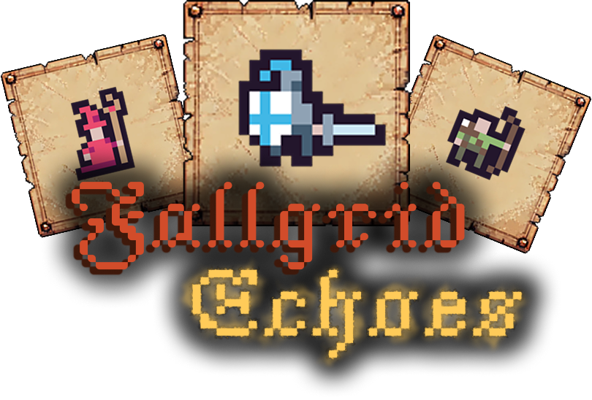
Roguelike game with “15 Puzzle” elements
Author: Vladyslav Voloshchuk
Supervisor: Ilya Porublyov
Notes:
Dear commission and attendees, today I present to you my coursework on the topic of development of a roguelike game with “15 puzzle” elements. Titled “Fallgrid Echoes”. My name is Vladyslav Voloshchuk, and my supervisor for this project was Ilya Porublyov.

Slide 2
Goal and objectives
Develop a prototype of a game.
Demonstrate core principles of object-oriented design.
Analyze existing implementations of the “15 Puzzle” and roguelike genre games
Select the main elements of both ideas
Design the general structure of the game
Implement everything into the game
Test the resulting game and draw conclusions
Notes:
The main goal of this coursework was to develop a prototype, that would demonstrate the core principles of object-oriented programming. Mainly focusing on polymorphism at that. Let’s now go through the main objectives to achieve that goal: First, an analysis is required, to highlight defining elements of both “15 Puzzle” and roguelike genre games.
Then, the list of the unique features should be filtered to the most important ones, and redesigned, according to the planned scope of the game.
After that, we will design the general structure and main algorithms Lastly, we will test the resulting prototype and draw the conclusions of the whole coursework

Slide 3
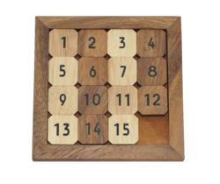
Analyzing “15 Puzzle”
Always has 1 empty spot
Moving the tile into the empty space
Main goal is to place tiles in order
solved “15 Puzzle”
Notes:
If you’re unfamiliar – 15 puzzle is a puzzle about reorganizing 15 tiles on a 4x4 grid in order. Since total amount of place in a 4x4 grid is 16, there is always one tile missing.
There are 2 possible places to put a character at: an empty space and a tile
In the first variant the character will now always occupy the empty spot on the grid and each movement will just be a swap of player and an adjacent tile In the second variant (e.g we replace tile numbered “7”) the player would have to move a lot of other tiles before the character get a place to move to. // and more importantly the atomic player action couldn’t be as simply generalized, so since the goal of this work is a demonstration of polymorphism, we will go with the variant 1.

Slide 4
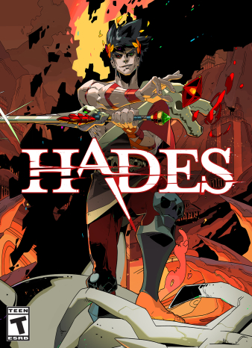
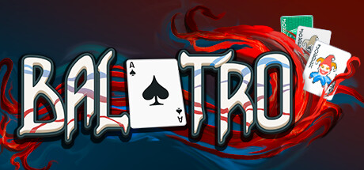
Analyzing “most loved” roguelike games
Balatro – roguelike based on the mechanics of Poker.
Hades – roguelike/dungeon crawler. Procedurally generates storylines and levels.
Notes:
For my analysis of roguelike games, I've chosen to showcase Balatro and Hades. Both games have earned high praise from the community over many years, making them excellent representatives of the genre.

Slide 5
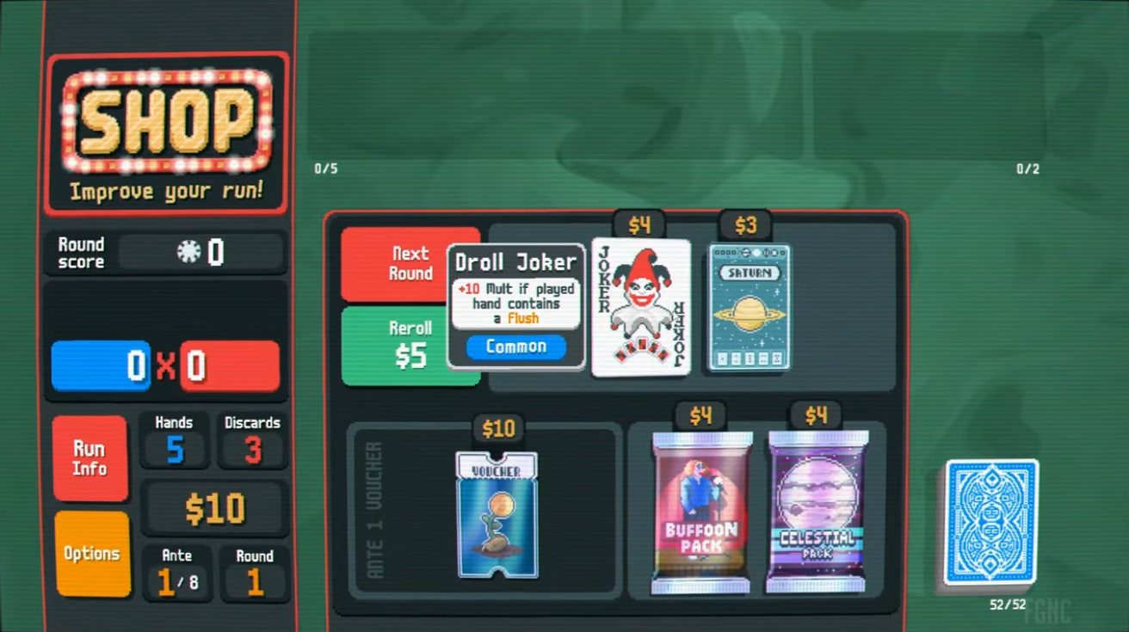
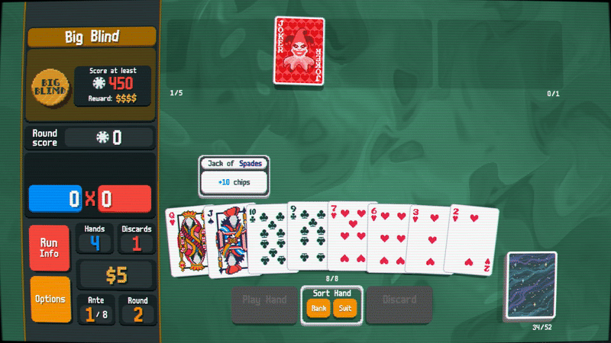
Balatro
Notes:
Balatro is a roguelike game, inspired by Poker. The main goal of Balatro is to achieve the score at each round. You get score for playing cards. You get more score for playing combinations of cards. The game-changing part starts when you finish the round. You get presented with a set of cards with unique effects. For example, the specific card illustrated on the screen multiplies the current score tenfold, whenever you submit a flush. These unique effects often work quite well with each other leading to many possible strategies, to beat the game with. The other unique feature of Balatro is an almost excessive amount of visual feedback, cards “punch” on click, tilt as you hover over them and glide in the air on drag.

Slide 6
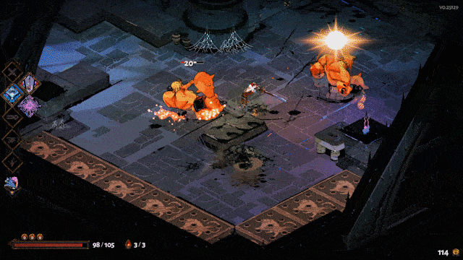
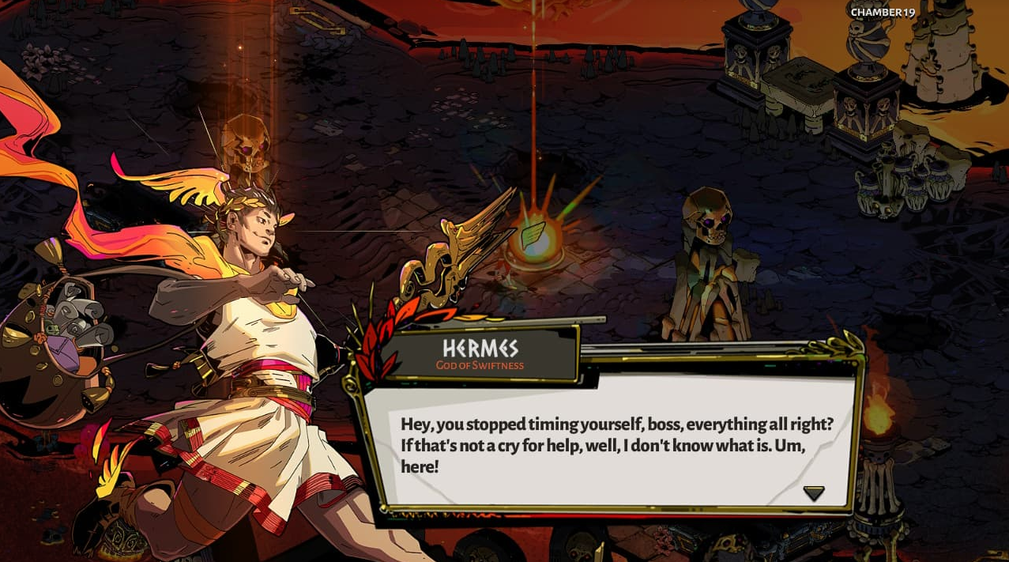
Hades
Notes:
Hades, as mentioned before, is a dungeon crawler/slasher.
The main gameplay loop is quite simple and should be familiar to most of the attendees today - you defeat enemies, room by room, collecting special abilities in-between.
The main point of this game, however, is not the fun and flashy gameplay. But instead, the uniqueness of each and every playthrough.
As you escape from the underworld you meet different gods along the way, some of them might show conditionally. For example, Hermes – Greek god of speed, will show up, if you complete rooms fast enough and don’t waste too much time choosing.
The gods will also sometimes share their daily stories, different responses to which will lead to different level designs and storylines.

Slide 7
Plans and selection of game elements
Build on the initial idea of the “15puzzle” mechanic:
Let the player swap tiles manually
Simpler visual feedback on input
Simplified procedural generation
A slight variety of game elements
Notes:
This leaves us with at least 3 great concepts, but in full scale they will just be too much for this prototype.
We going to build on top the idea of “15puzzle”, but to successfully implement all of the other mechanics, they will require significant simplifications:
visual feedback will be reduced to the most common states (hover, drag and idle) procedural generation will only depend on the current stage of the game and we will create only just enough different tile types, to demonstrate the efficiency of oop concepts

Slide 8
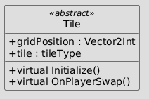
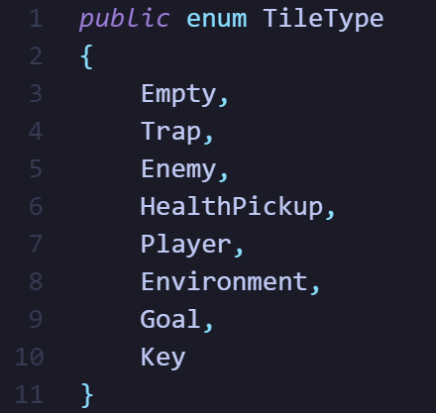
Design
Grid, filled with tiles.
Empty, Enemy, Player, Environment
Goal and Key
Health potion and Trap
Notes:
The game will consist of

Slide 9
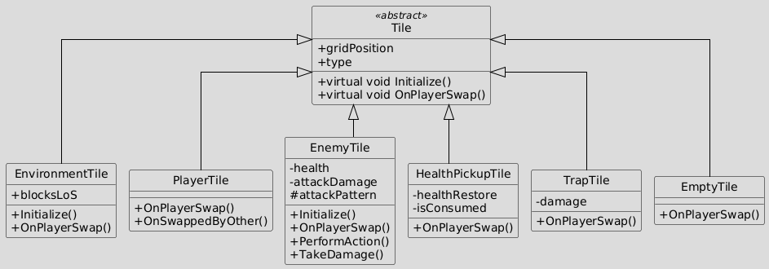
Design of Tile hierarchy

Slide 10
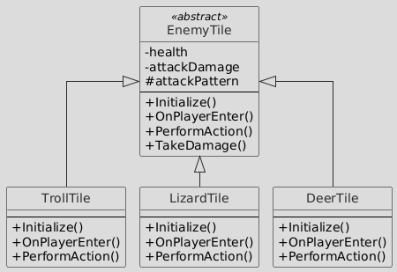
Design of EnemyTile hierarchy

Slide 11
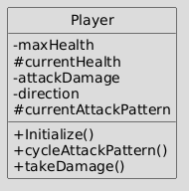
Design of Player class
health, attackDamage, direction are private
currentHealth, currentAttackPattern are protected

Slide 12
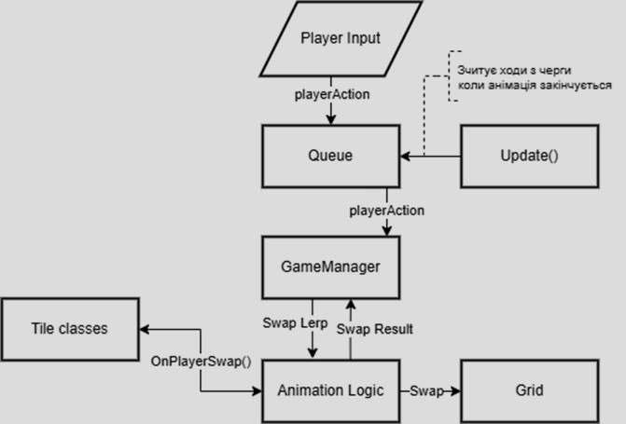
Design of general game logic

Slide 13
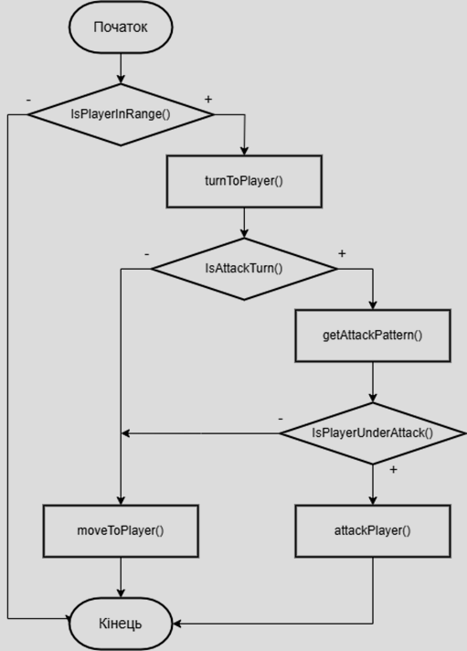
Enemy logic design

Slide 14
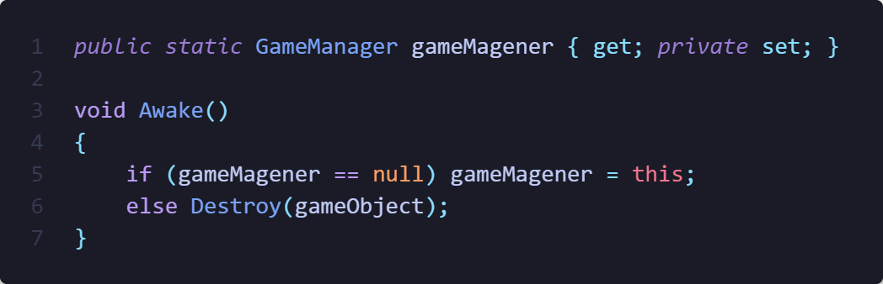
Implementation::Tile

Slide 15
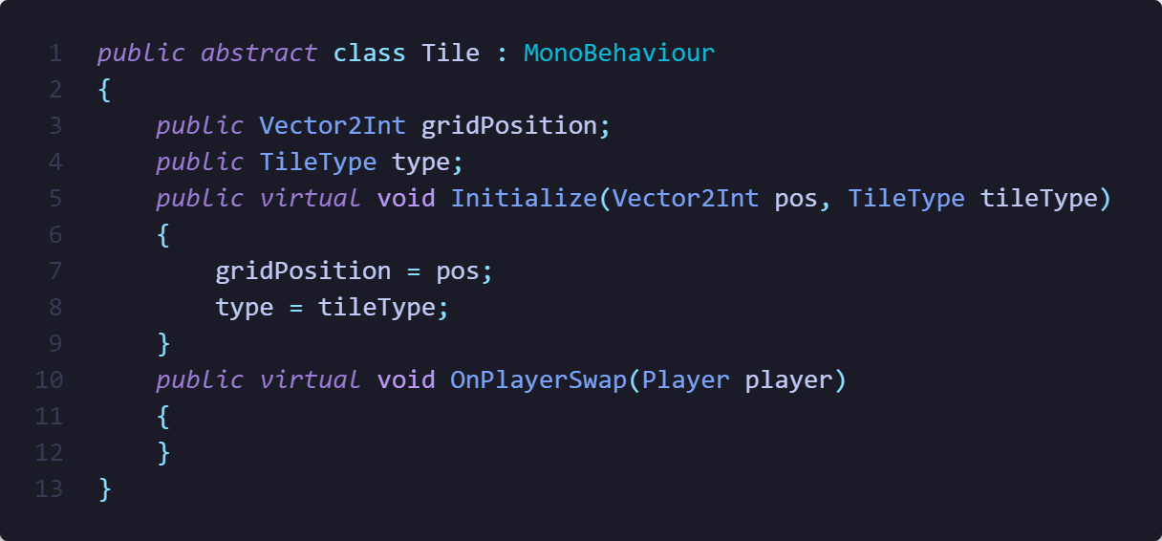
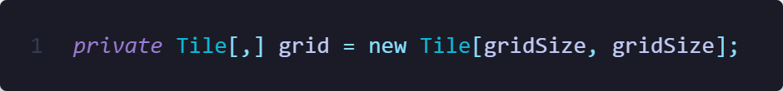
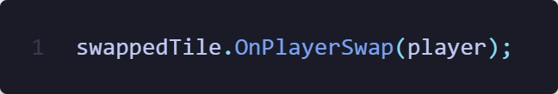
Implementation::Tile

Slide 16
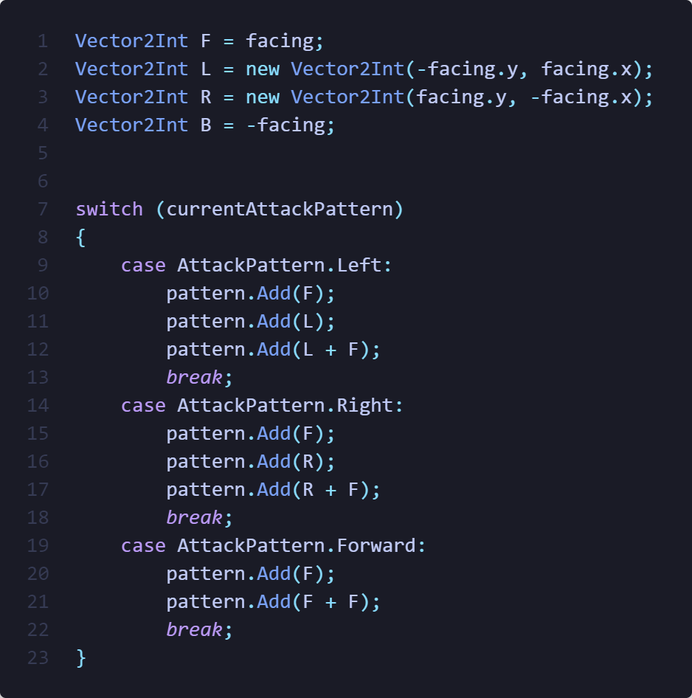
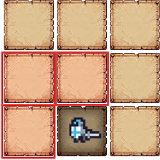
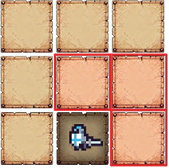
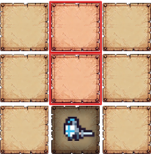
Implementation::AttackPattern
Left
Right
Forward

Slide 17
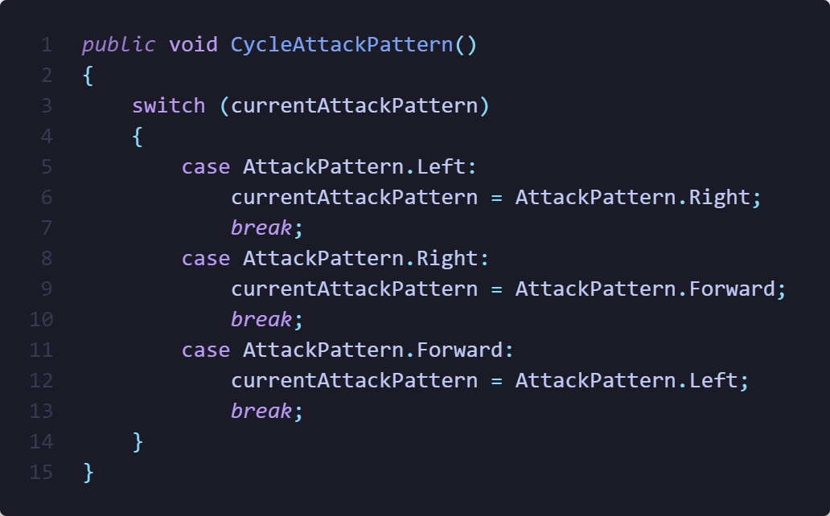
Implementation::AttackPattern

Slide 18
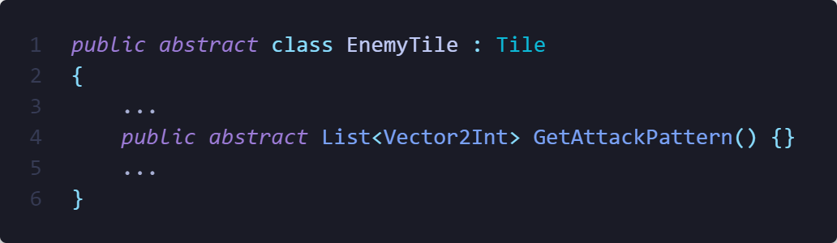
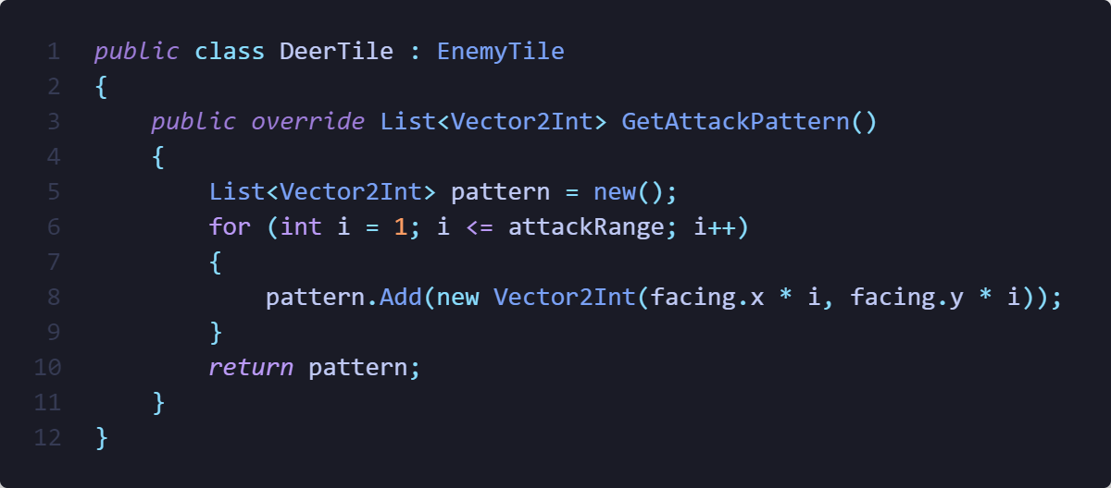
Implementation::EnemyAttackPattern

Slide 19
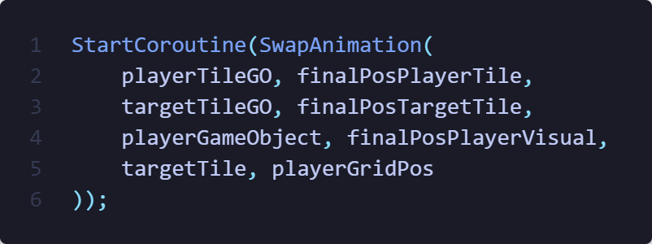
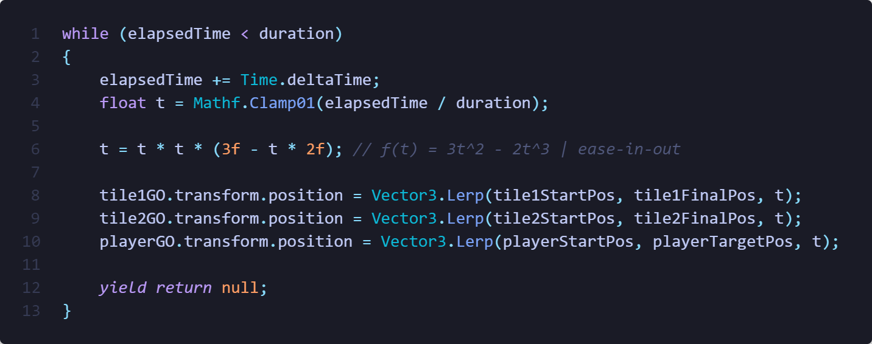
Implementation::Animation

Slide 20
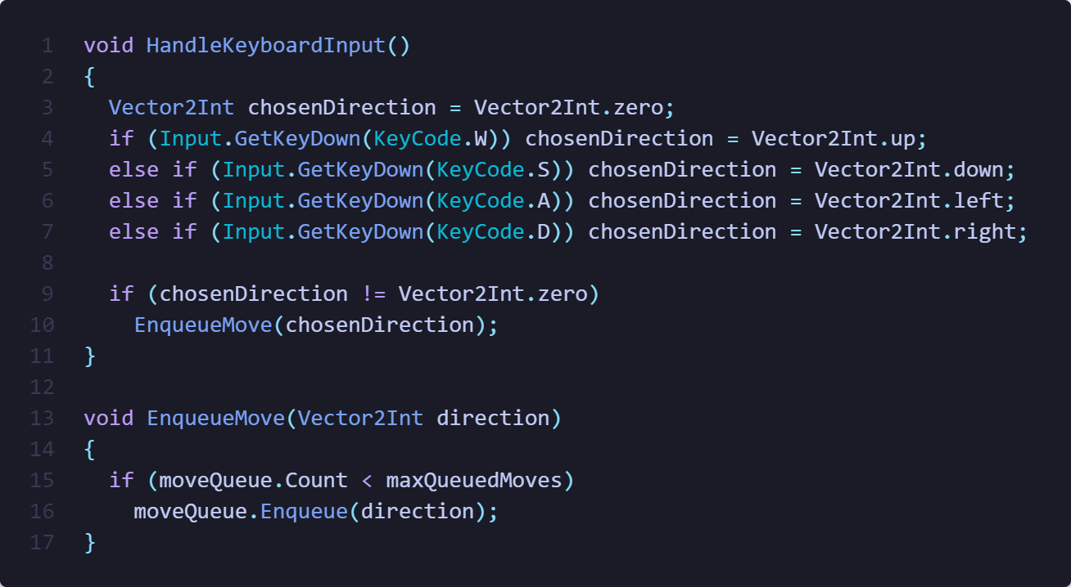
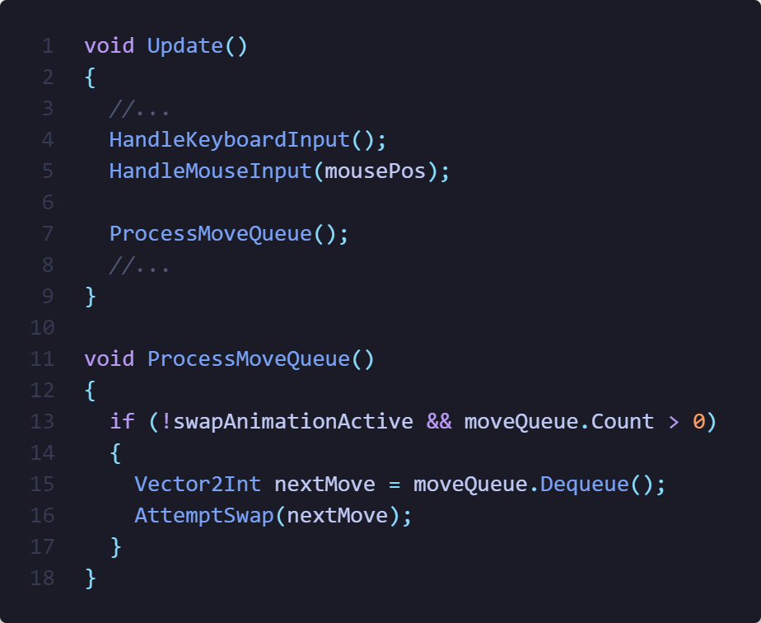
Implementation::Queue

Slide 21
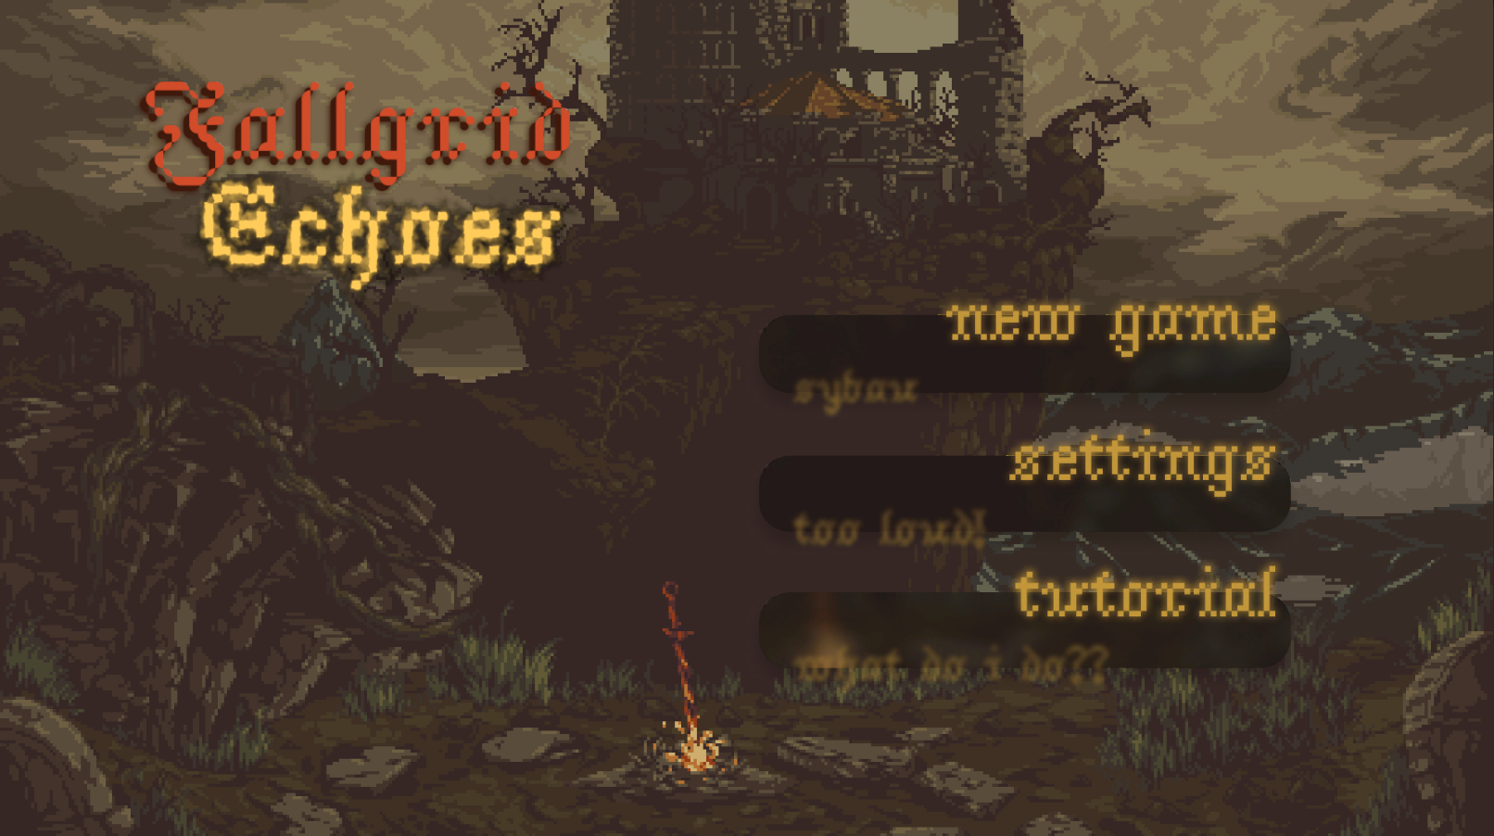
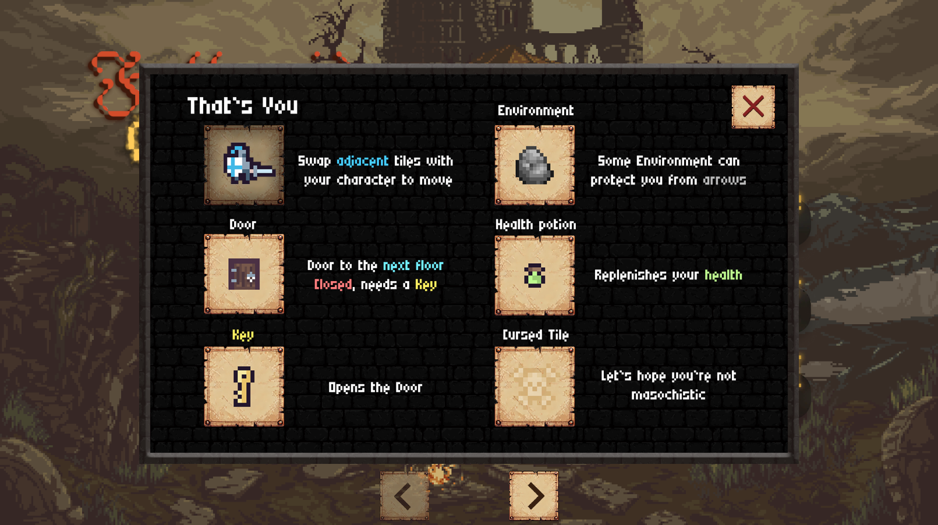
Results::Menu

Slide 22
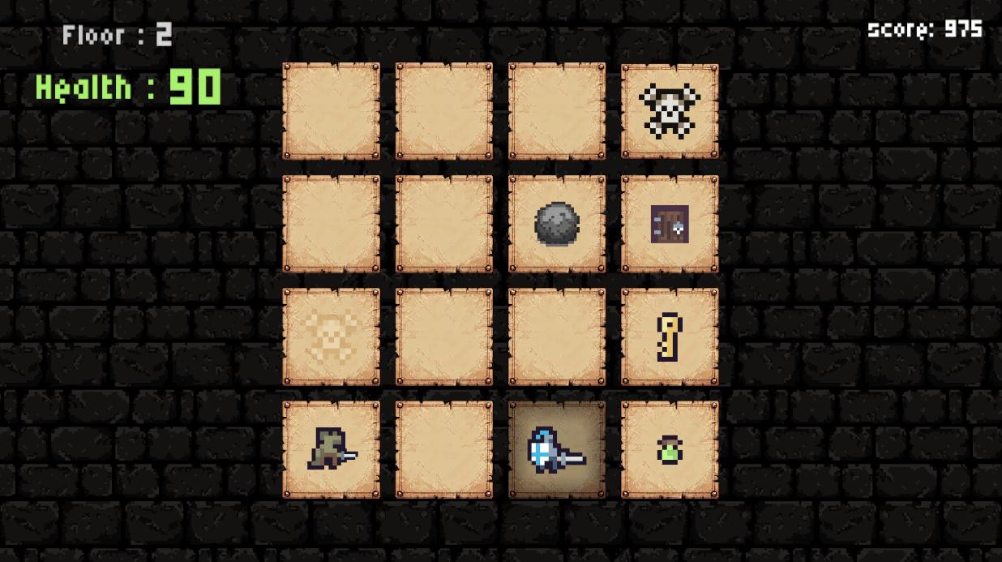
Results::Swap

Slide 23
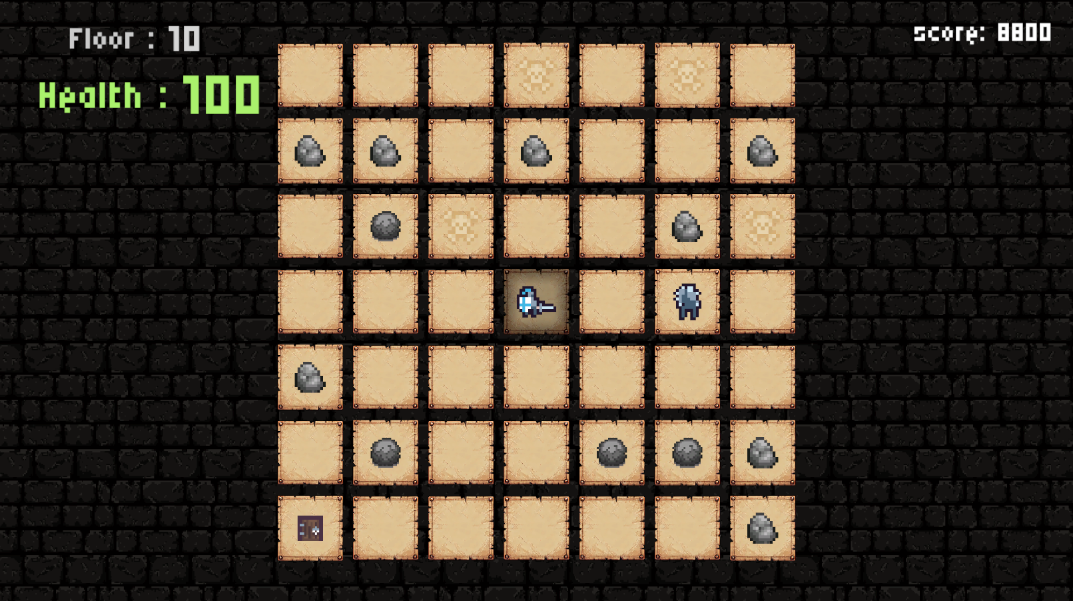
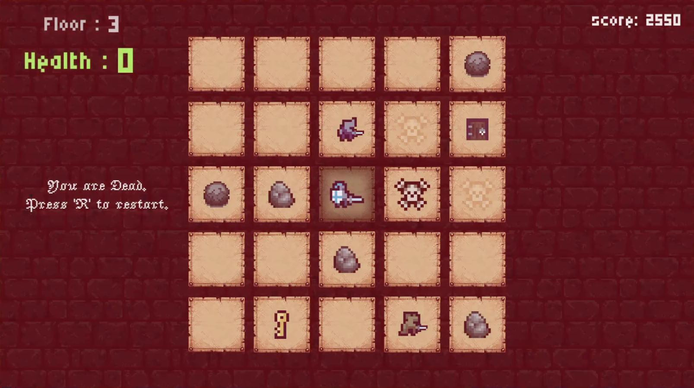
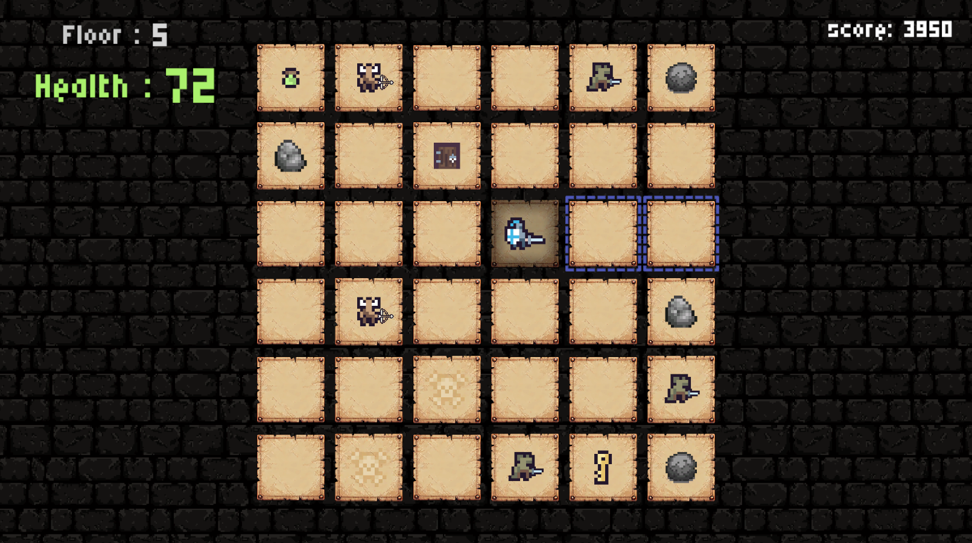
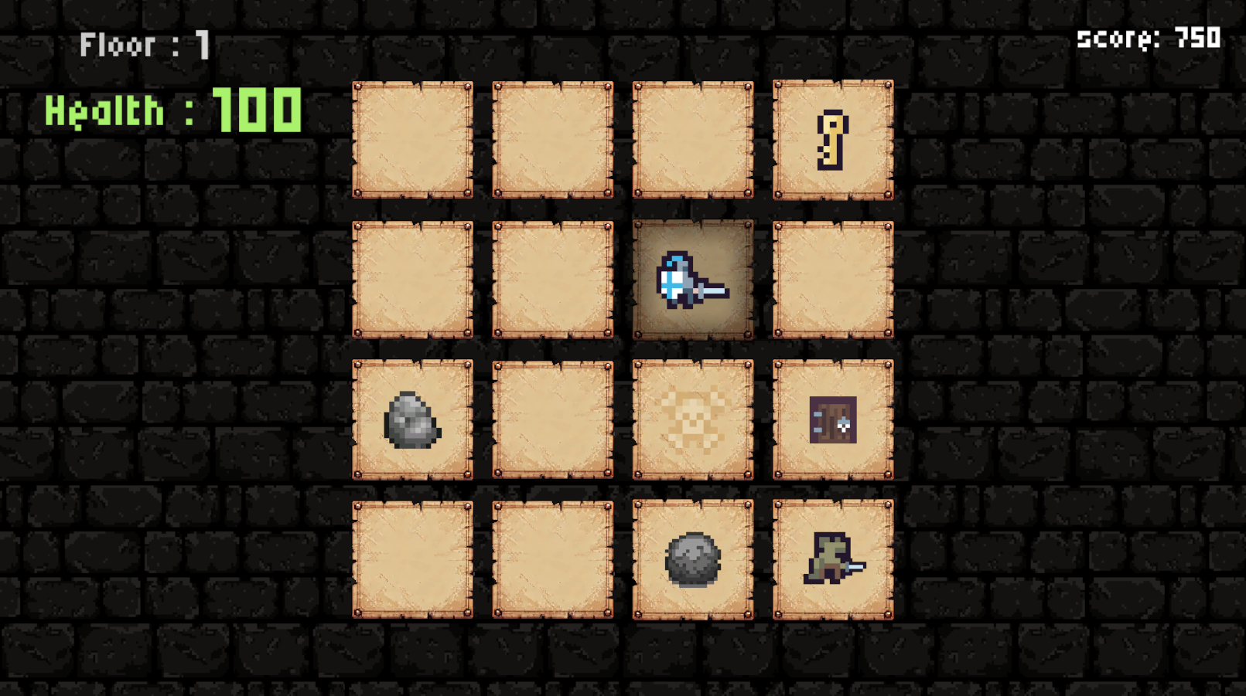
Results::LevelGeneration

Slide 24
Conclusion
Fully functioning prototype
Demonstration of object-oriented design principles
OnPlayerSwap()
PerformAction()
GetAttackPattern() *enemy tiles
All planned out features

Slide 25
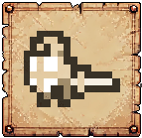
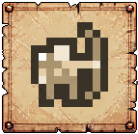
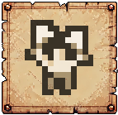
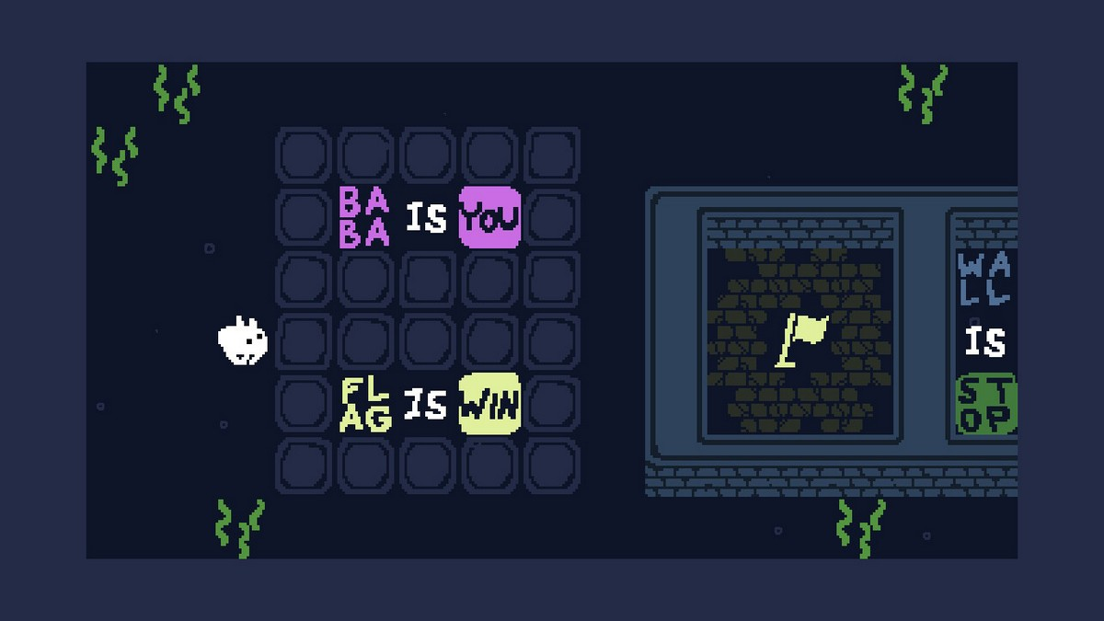
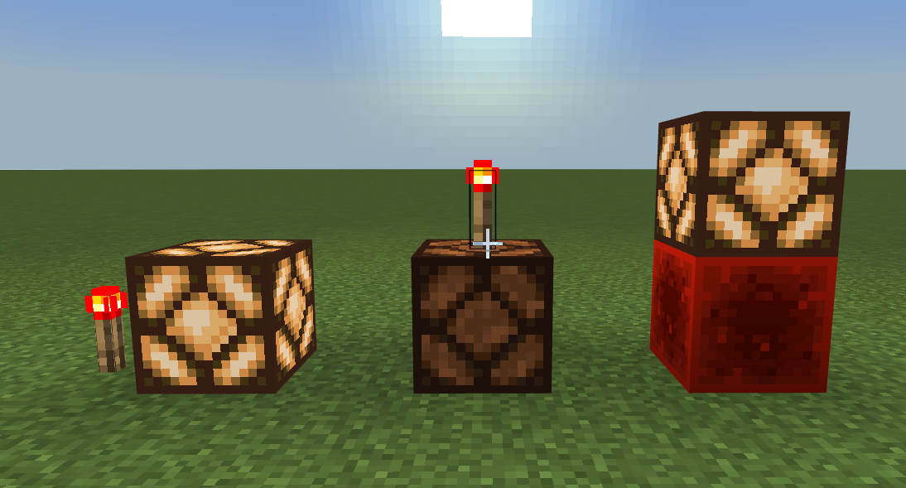
Possible future improvements
Add other playable characters
Generalize attack patterns into an interface
Dynamic tile states, depending on adjacent tiles

Slide 26
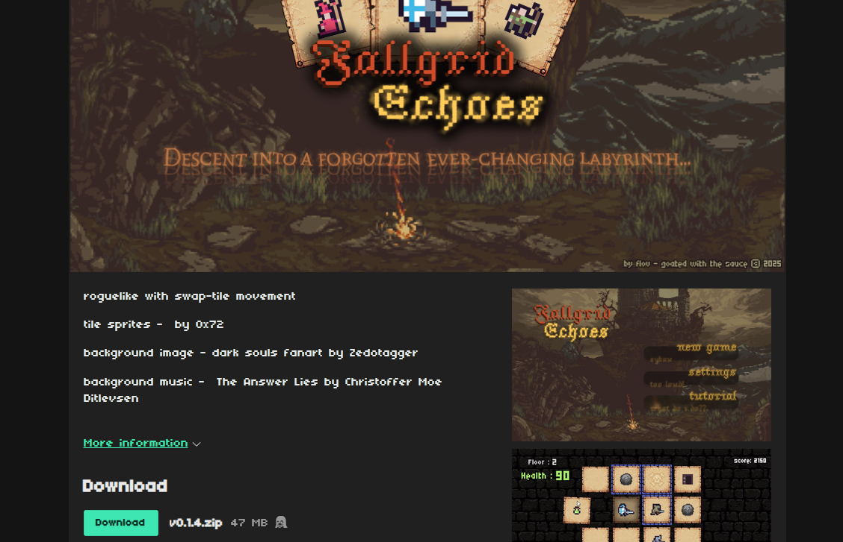
Thank you
published at:
source code:
flovnes.itch.io/fallgridechoes github.com/flovnes/fallgridechoes

